Slide 1

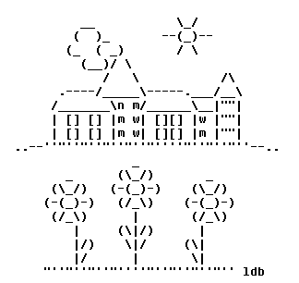
Introduction to Computer Science
Reichman University
Lecture 3-2
Handling Characters and Text
Notes:
1

Slide 2
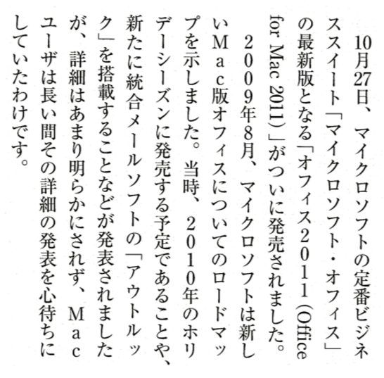
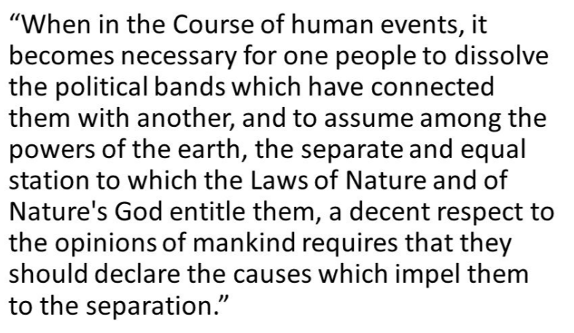
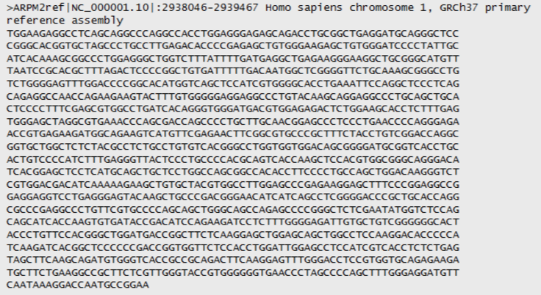
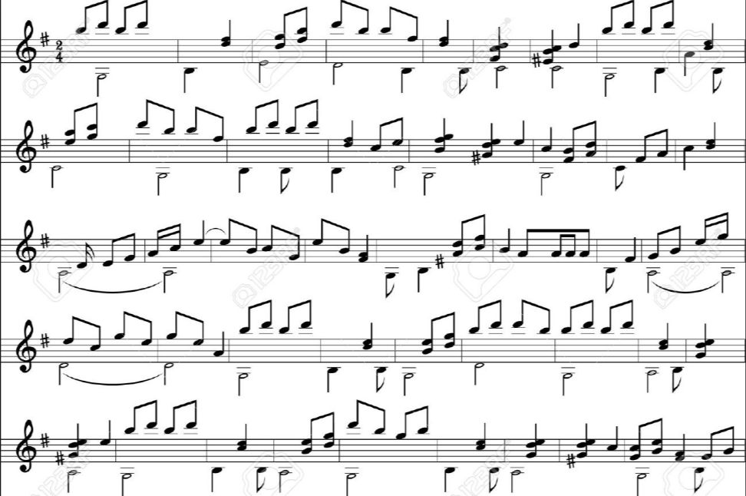
Textual data
Data = a stream of characters;
Every character is represented by a numeric code;
In Java, these codes are handled by the data type char.

Slide 3
The char data type
type | bits | range of values
byte | 8 | -128 ... 127
short | 16 | -32,768 ... 32,767
char | 16 | 0 ... 65,535
int | 32 | -2,147,483,648 ... 2,147,483,647
long | 64 | < -9 x 10¹⁸ ... > 9 x 10¹⁸
Java data types for representing integers
char values are integers
When we say print('k'), the computer displays an image that looks like k
But the code itself – the char value that represents 'k' – is the number 107.

Slide 4
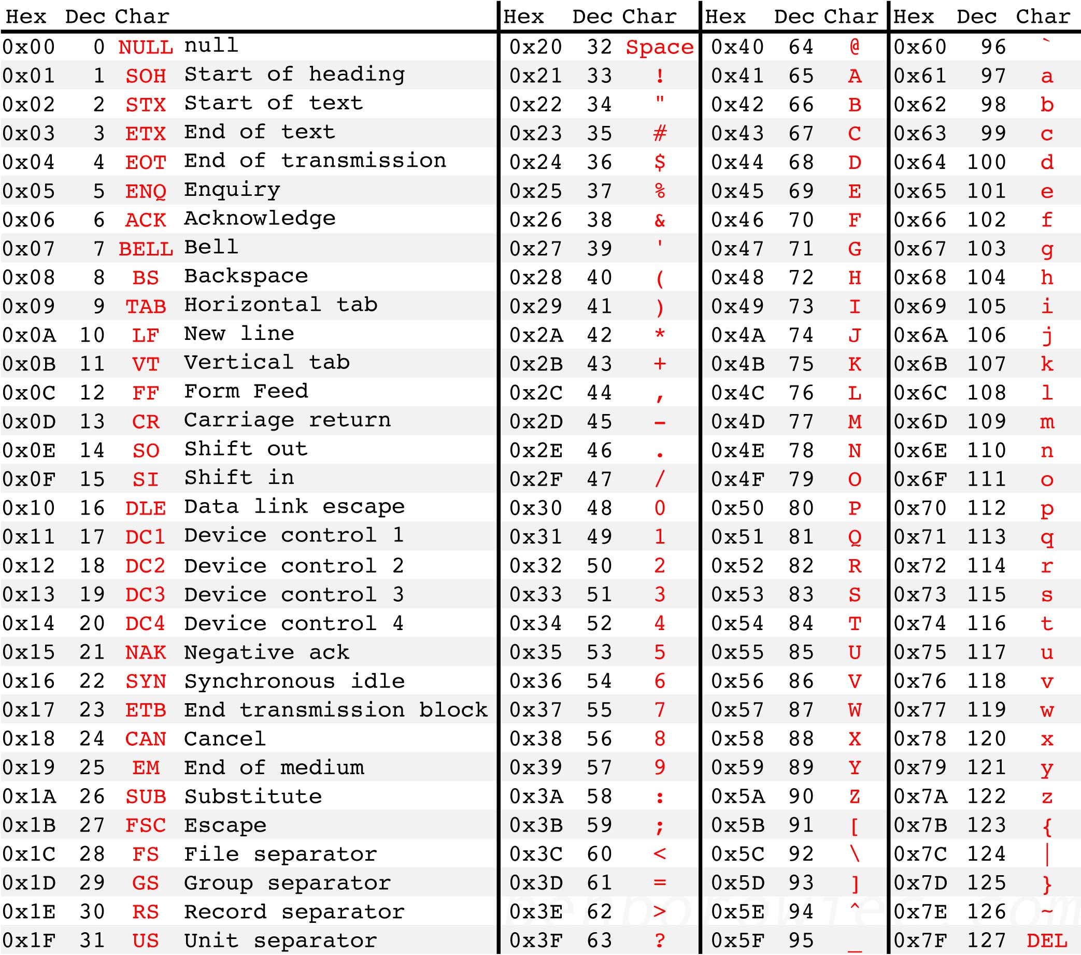
Character codes: ASCII
Character set
A set of characters, and their codes;
Each character is represented by an agreed-upon numeric code.
ASCII
8-bit code character set for representing western alphabets (a standard formed in 1963):
0-31: Control characters
32-127: Common western characters

Slide 5
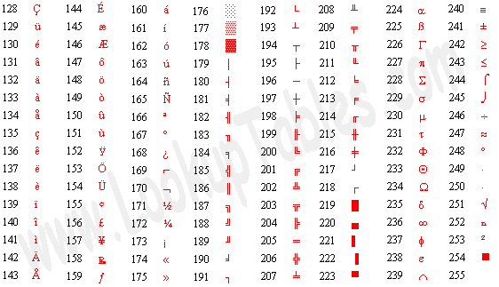
Character codes: ASCII
Character set
A set of characters, and their codes;
Each character is represented by an agreed-upon numeric code.
ASCII
8-bit code character set for representing western alphabets (a standard formed in 1963):
0-31: Control characters
32-127: Common western characters
128-255: More characters, mostly graphics primitives

Slide 6
Character codes: Unicode
ASCII (1963): an 8-bit code that represents 2⁸ = 256 characters
Unicode (1991): a 16-bit code that can represent 2¹⁶ = 65536 characters
Java uses Unicode.
ASCII is embedded within Unicode. For example:
'a' in ASCII: 0110001 (97 in decimal)
'a' in Unicode: 000000000110001 (97 in decimal).

Slide 7

Plan
ASCII / Unicode
Characters
Strings
String processing examples

Slide 8
Characters in action
// CharDemo.java
...
System.out.println(3);
3

Slide 9
Characters in action
// CharDemo.java
...
System.out.println(3);
System.out.println('3');
System.out.println(3 + 1);
System.out.println('3' + 1);
char c = 8096; // sets c to some arbitrary value
System.out.println(c);
System.out.println('h');
System.out.println('h' – 1);
c = 'd';
// Converts to uppercase:
System.out.println(c – 32);
System.out.println((char) (c – 32));
c = 'K';
// Converts to lowercase:
// You do it
c = 't';
// Checks if c is a lowercase letter:
System.out.println((c >= 97) && (c <= 122));
System.out.println((c >= 'a') && (c <= 'z')); // more readable
c = '7';
// Checks if c is a digit:
// You do it
...
3
3
4
52
ᾠ
h
103
68
D
true
true

Slide 10

A peek into how computers work (sneak preview)
Internal view:
In memory, x stores the binary code of 97:
00000000000000000000000001100001
int x = 97;
System.out.println(x);
97
Anatomy of System.out.println(x):
Java converts the code 00000000000000000000000001100001 to decimal; The result is 97
Java extracts the digits of 97, left to right: first the 9, then the 7
Java looks up the ASCII / Unicode table, and finds that '9' and '7' are represented as 57 and 55
Java tells the OS “display the images of ASCII codes 57 and 55”
The OS looks up 57 in the current font table, and sees that it is represented by a matrix of pixels that creates the image 9; it displays this image on the screen. The OS does the same with 55
The user sees 97 on the screen, completely unaware of the underlying drama.

Slide 11
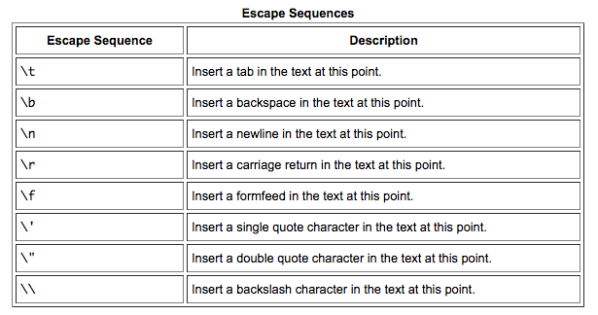
Special characters
example:
System.out.println("I don\'t like\nthe word \"no\"");
I don't like
the word "no"
Patterns that begin with a backslash (\) are called escape sequences

Slide 12
Plan
ASCII / Unicode
Characters
Strings
String processing examples

Slide 13
Strings
String s1 = "As easy ";
0
1
2
3
4
5
6
7
high-level view
s1:
A
s
e
a
s
y
0
1
2
3
4
5
6
7
low-level view
s1:
65
115
32
101
97
115
121
32
...
...
Notes:
Atoms and molecules

Slide 14
Strings
String s1 = "As easy ";
0
1
2
3
4
5
6
7
s1:
A
s
e
a
s
y
Notes:
Atoms and molecules

Slide 15
Strings
String s1 = "As easy ";
String s2 = "as 123";
0
1
2
3
4
5
6
7
s1:
A
s
e
a
s
y
0
1
2
3
4
5
s2:
a
s
1
2
3
Notes:
Atoms and molecules

Slide 16
Strings
String s1 = "As easy ";
String s2 = "as 123";
String s3 = s1 + s2;
0
1
2
3
4
5
6
7
s1:
A
s
e
a
s
y
0
1
2
3
4
5
s2:
a
s
1
2
3
0
1
2
3
4
5
6
7
8
9
10
11
12
13
s3:
A
s
e
a
s
y
a
s
1
2
3
Notes:
Atoms and molecules

Slide 17
Strings
String s1 = "As easy ";
String s2 = "as 123";
String s3 = s1 + s2;
System.out.println(s1.length());
8
0
1
2
3
4
5
6
7
s1:
A
s
e
a
s
y
0
1
2
3
4
5
s2:
a
s
1
2
3
0
1
2
3
4
5
6
7
8
9
10
11
12
13
s3:
A
s
e
a
s
y
a
s
1
2
3

Slide 18
Strings
String s1 = "As easy ";
String s2 = "as 123";
String s3 = s1 + s2;
System.out.println(s1.length());
System.out.println(s1.charAt(3));
System.out.println(s1.substring(1,5));
System.out.println(s3.indexOf('a'));
8
e
s ea
4
0
1
2
3
4
5
6
7
s1:
A
s
e
a
s
y
0
1
2
3
4
5
s2:
a
s
1
2
3
0
1
2
3
4
5
6
7
8
9
10
11
12
13
s3:
A
s
e
a
s
y
a
s
1
2
3

Slide 19
Strings
String s1 = "As easy ";
String s2 = "as 123";
String s3 = s1 + s2;
System.out.println(s1.length());
System.out.println(s1.charAt(3));
System.out.println(s1.substring(1,5));
System.out.println(s3.indexOf('a'));
Methods are similar to functions
Unlike functions, methods operate on objects
In particular, string methods operate on string objects
Instead of writing: charAt(s1,3), we write: s1.charAt(3)
Method calls
8
e
s ea
4
Much more about objects and methods: Second half of the course.
0
1
2
3
4
5
6
7
s1:
A
s
e
a
s
y
0
1
2
3
4
5
s2:
a
s
1
2
3
0
1
2
3
4
5
6
7
8
9
10
11
12
13
s3:
A
s
e
a
s
y
a
s
1
2
3

Slide 20
Plan
ASCII / Unicode
Characters
Strings
String processing examples

Slide 21
Example: Upcase
/** A library of string functions. */
public class MyString {
public static void main(String args[]) {
System.out.println(upCase(args[0]));
}
/** Capitalizes the first letter in every word in the string. */
public static String upCase(String str) {
% java MyString "it was the best of time"
It Was The Best Of Time

Slide 22
Example: Upcase
/** A library of string functions. */
public class MyString {
public static void main(String args[]) {
System.out.println(upCase(args[0]));
}
/** Capitalizes the first letter in every word in the string. */
public static String upCase(String str) {
String ans = "" + (char) (str.charAt(0) - 32);
int i = 1;
while (i < str.length()) {
char ch = str.charAt(i);
if (ch == ' ') {
ans = ans + ch + (char) (str.charAt(i + 1) - 32);
i++;
} else {
ans = ans + ch;
}
i++;
}
return ans;
}
}
% java MyString "it was the best of time"
It Was The Best Of Time
% java MyString "2 apples and 3 pears"
Apples and 0ears
Problems with this version of upCase:
Makes implicit assumptions about the input
Does not handle white space and non-letter characters.

Slide 23
Example: Parsing
Task: Parse a string that has the following semantics:
char int char int char int …
example:
% java Parse T5A12C432G3

Slide 24
Example: Parsing
Tokenizing
The process of turning a stream of characters into a stream of tokens
The definition of token varies from one application to another
Comes up in numerous applications
Tokenizer
A class that provides tokenizing services.
Task: Parse a string that has the following semantics:
char int char int char int …
example:
% java Parse T5A12C432G3
T
5
A
12
C
432
G
3
The program “tokenizes” the string, printing each token in a separate line.

Slide 25
Example: Parsing
Tokenizing
The process of turning a stream of characters into a stream of tokens
The definition of token varies from one application to another
Comes up in numerous applications
Tokenizer
A class that provides tokenizing services.
/** A (typical) string tokenizer. Gets the next token in a given string. */
public class Tokenizer {
/** Initializes the Tokenizer to the given string (str). */
public static void init(String str)
/** Returns true if the string has more characters to process,
* false otherwise. */
public static boolean hasMoreChars()
/** Returns the next character in the string. */
public static char nextChar()
/** Returns the next int value in the string. */
public static int nextInt()
// More tokenizer functions...
}
TokenizerAPI:
% java Parse T5A12C432G3
T
5
A
12
C
432
G
3

Slide 26
Example: Parsing
...
// The code below can appear in any class. For example, a class that processes DNA data.
...
// DNA data typically comes from a file. Here we assume it comes from the command-line.
// Puts the DNA data in s, then parses and prints each token in s a separate line.
String s = args[0];
The code on the left, taken from the Parse class, illustrates the Tokenizer services.
/** A (typical) string tokenizer. Gets the next token in a given string. */
public class Tokenizer {
/** Initializes the Tokenizer to the given string (str). */
public static void init(String str)
/** Returns true if the string has more characters to process,
* false otherwise. */
public static boolean hasMoreChars()
/** Returns the next character in the string. */
public static char nextChar()
/** Returns the next int value in the string. */
public static int nextInt()
// More tokenizer functions...
}
TokenizerAPI:
% java Parse T5A12C432G3
T
5
A
12
C
432
G
3

Slide 27
Example: Parsing
...
// The code below can appear in any class. For example, a class that processes DNA data.
...
// DNA data typically comes from a file. Here we assume it comes from the command-line.
// Puts the DNA data in s, then parses and prints each token in s a separate line.
String s = args[0];
// Initializes the Tokenizer to the given string
Tokenizer.init(s);
// Parses and prints the tokens (assuming the format char int char int char int ...)
while (Tokenizer.hasMoreChars()) {
System.out.println(Tokenizer.nextChar());
// Following the character, there must be an int value
System.out.println(Tokenizer.nextInt());
}
...
The code on the left, taken from the Parse class, illustrates the Tokenizer services.
Note how this code uses the Tokenizer functions as “black box abstractions”; It need not know how they are implemented. It just needs the API.
/** A (typical) string tokenizer. Gets the next token in a given string. */
public class Tokenizer {
/** Initializes the Tokenizer to the given string (str). */
public static void init(String str)
/** Returns true if the string has more characters to process,
* false otherwise. */
public static boolean hasMoreChars()
/** Returns the next character in the string. */
public static char nextChar()
/** Returns the next int value in the string. */
public static int nextInt()
// More tokenizer functions...
}
TokenizerAPI:
% java Parse T5A12C432G3
T
5
A
12
C
432
G
3

Slide 28
Example: Tokenizing
/** A (typical) string tokenizer. Gets the next token in a given string. */
public class Tokenizer {
Let’s open the black box

Slide 29
Example: Tokenizing
/** A (typical) string tokenizer. Gets the next token in a given string. */
public class Tokenizer {
private static String str; // the string to parse
private static int N; // string length (number of characters)
private static int cursor; // current position in the string
/** Initializes the Tokenizer to the given string (str). */
public static void init(String s) {
str = s;
N = str.length();
cursor = 0;
}
/** Returns true if the string has more character to process, false otherwise. */
public static boolean hasMoreChars() {
// put your code here
}
/** Returns the next character in the string.
* Should be called only if hasMoreChars() is true. */
// Side effect: advances the cursor just beyond the character.
public static char nextChar() {
// put your code here
}
/** Returns the next int value in the string.
* Should be called only if hasMoreChars() is true. */
// Side effect: advances the cursor just beyond the integer.
public static int nextInt() {
// put your code here
}
// Returns true if the given character is a digit, false otherwise.
private static boolean isDigit(char c) {
// put your code here
}
}
Class variables:
Can be accessed by any function in the class
Class members
The class variables and functions are called “class members”.
public: Can be accessed by members of any class; Provides the class services, documented by the class API.
private: Accessed only by members of this class. Provides “helper” services to other class members
(Notice the different documentation style of private and public members)
Completing the Tokenizer code:
Give it a try.

Slide 30
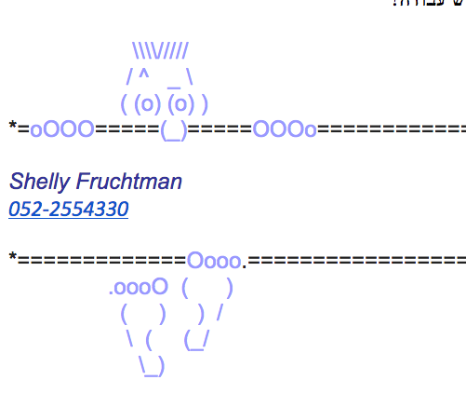
Introduction to Computer Science
Shimon Schocken
IDC Herzliya
Lecture 3-2
Handling Characters and Text
Notes:
30

